Slide 1
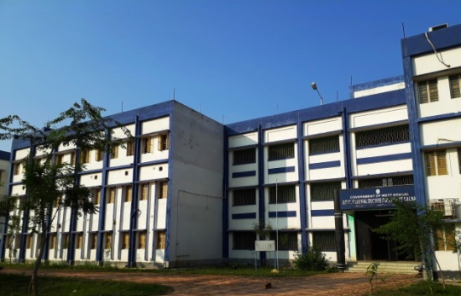
2021-22
ADMISSION BROCHURE
Government General Degree College ,
Kalna-I
Muragacha, Medgachi, Purba Bardhaman 713405

Slide 2
ROADMAP
Admission brochure 2021-22
Sl. No. | Content | Page No.
1 | Principal’s Desk | 01
2 | About College | 02
3 | Vision and Mission | 03
3 | Courses Offered at a Glance | 04
4 | Departmental Tour in 5 Minutes :
 | Physics | 05
 | Chemistry | 06
 | Mathematics | 07
 | Education | 08
 | Philosophy | 09
 | History | 10
 | Bengali | 11
 | English | 12
 | Sanskrit | 13
 |  | Contd.

Slide 3
ROADMAP
Admission brochure 2021-22
Sl. No. | Content | Page No.
5 | Students' Corner
 | Facilities in Brief | 14
 | Library | 15
 | Smart Classroom & Auditorium | 16
 | Science & Computer Laboratory | 17
 | Co-curricular Activities
 | Sports | 18
 | Outreach activities | 19
 | Cultural Events | 20
6 | Teaching-learning during pandemic | 21,22
7 | Green & Clean | 23,24
8 | NSOU | 25
9 | Institutional Governance | 26
10 | IQAC | 27
11 | College Rules & Regulations | 28
12 | Eligibility Criteria & Index calculation | 29
13 | Detailed seat distribution | 30
14 | Subject Combinations | 31
15 | Fee Structure | 32
16 | Projected reach | 33
17 | Concluding Remarks | 34

Slide 4
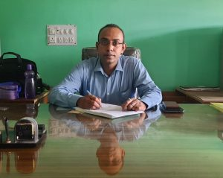
KEY NOTES
Principal’s Desk
Prof. (Dr.) Krishnendu Dutta
WBSES,
Principal, GGDCK I
It has been a busy but fulfilling five months in the Principal’s chair. Taking charge of a newly established college in the middle of the pandemic had its odds, however, with the support of the group dedicated faculties and staff of the college, I have been able to address them and the college is perfectly ready to pursue its high ideals. The forced shift from the traditional chalk-board and classroom teaching to an on-line method of education has been the greatest challenge to all of us. This college too, had to prepare for it at a fast pace. In order to do so, certain infrastructural inclusions were required. In addition to that there was also a need to impress and convince everyone concerned towards the new, and necessary, mode of on-line education.
For the smooth functioning of the on-line mode some immediate long and short-term measures had to be taken, such as subscribing the ‘Learning Management System’ in place. With support from my colleagues regular classes were shifted to the Google Classrooms via Google Meet. Teachers and students were encouraged to use Google classroom, which has become in this brief period a repository of study materials, video lectures of classes and a very dependable interactive platform for teachers and students. Practical classes were conducted using Virtual Lab.
It was not enough to merely conduct classes virtually. The feel of a college rests upon extracurricular activities and interactions, hence competitions were held for students to make them adapt to the new mode in different ways. We decided to hold webinars the institutional best practice for this academic year, and that drew and acclimatized everyone to the on-line system. As the pandemic situation is still prevailing, the college at this moment is well settled to function on-or-off line mode for holding all co-curricular and extracurricular activities.
Since it is a new college, it needed to be structured and readied to match the criteria set down by the accreditation council (NAAC). Necessary steps such as arranging for Feedback, Alumni participation were undertaken. However, it was also necessary to address the needs of the students of this region, who were economically crippled by the pandemic conditions. Among the several steps taken, it is necessary to mention the reduction of fees and the involvement of the NSS unit to reach out to the nearby villages and extend help and support by providing food supplies from time to time.
As the Principal of the college, it gives me great pleasure for being a part of these commendable activities. I warmly welcome all our new entrants and I am sure they will join us in our future endeavours.

Slide 5
FEW NOTES
About our College
Founded in the year of 2015, affiliated to The University of Burdwan.
Campus with 6.72 acres of land.
The college offers new opportunities and imparts all-round education to the predominantly first-generation learners from the semi-urban and rural belts.
The college aims for holistic development of its students and offers necessary facilities.
The college is marching on the road to success with its group of young, energetic and dedicated teachers.
The teaching learning activities of the college strictly adhere to the methodologies of Education 3.0, such as flip learning and blended learning along with an extensive use of ICTs.
It has the most modern educational amenities, such as state-of-the-art laboratories, smart classrooms and a well-stocked library.
Gender sensitization is valued among all the members of the college.

Slide 6
KEY OBJECTIVES
Vision and Mission
Vision
The vision of this college is to provide lifelong education which facilitates the academic, creative and professional excellence of our learners by nurturing their innate sensibilities and inculcating social values.
To include learners from various socio-economic backgrounds and make higher education accessible and inclusive.
To promote ICT enabled platforms for the purpose of effective teaching, learning and evaluation.
To provide comprehensive idea about the changes and challenges in higher education as well as vocational opportunities, globally.
To encourage creative as well as critical thinking and help the learners imbibe a collaborative team spirit.
To inculcate the values of the communities among the future contributors of our society.
Mission

Slide 7
COURSES OFFERED
Academic Session 2021-2022
B.Sc. Honours
Sl no | Subject | Intake capacity | Current faculty strength
1 | Physics | 15 | 03
2 | Chemistry | 15 | 03
3 | Mathematics | 25 | 04
B.A. Honours
Sl no | Subject | Intake capacity | Current faculty strength
1 | Bengali | 31 | 03
2 | English | 31 | 03
3 | Sanskrit | 31 | 03
4 | Education | 31 | 04
5 | Philosophy | 31 | 03
6 | History | 31 | 02
General Courses
Sl no | Courses | Intake capacity
1 | B.Sc. General | 25
2 | B.A. General | 272

Slide 8
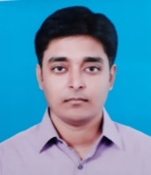
PHYSICS
Academic Departments
The Department of Physics has started functioning from the very inception of the college with the introduction of General course in Physics in 2015 under the aegis of the University of Burdwan. The department has begun to offer Honours course in this subject since 2016.
The department has an apposite number of proficient and accomplished faculties from prestigious institutions across the country. It is flourished with modern classrooms and well equipped laboratories. The laboratories are appropriate for electrical, electronic and optical experiments. The department is furnished with a computer laboratory as well. The college library has a huge collection of Physics books that provides with a balanced weightage of text and reference books.
The indomitable sincerity of the teachers is truly manifested through their vigorous effort of quenching the students’ thirst for knowledge creating an effective and friendly learning environment. To impart knowledge, motivate the students and inspire their achievements are the mottos of this department which are the gateway of true learning.
Faculty Members
Dr. Mahatsab Mandal (HoD)
Assistant Professor,
M.Sc., Ph.D. (SINP)
Specialization : High Energy Physics
Dr. Tanmay Das
Assistant Professor,
M.Sc., Ph.D. (TIFR, Mumbai)
Specialization : Nonlinear Dynamics
Dr. Sushovan Lala
Assistant Professor,
M.Sc., Ph.D. (BU)
Specialization : Materials science

Slide 9
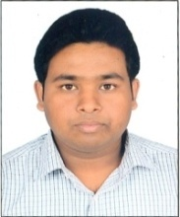
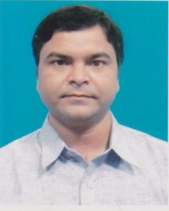
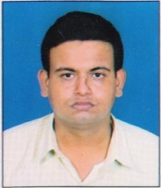
CHEMISTRY
Academic Departments
The Department of Chemistry of Government General Degree College at Kalna-1 started functioning in 2015 since the inception of the College and offers six semester undergraduate Honours in the subject under the affiliation of the University of Burdwan. Presently the intake capacity of the department is 15 under CBCS. The faculty members of the Department are fully committed to their duties and obligations. The Department laboratory is well equipped with state of the art instruments. The Departments continuous stride in academic excellence over the years is reflected in their teaching and their active engagement in research culture and publication of several research papers in reputed peer reviewed Journals. The teachers strive to continuously upgrade and keep abreast with the recent trends in the subject areas and also to infuse their students with values of dedication and diligence. The diverse qualifications of the faculty ensure expertise in all the traditional disciplines of chemistry as well as in various interdisciplinary areas.
The department provides a conducive intellectual environment for the curious and inventive youngsters through departmental seminars and quiz. Classrooms offer a good deal of faculty-student interaction which strengthens the bond between them and academic flexibility to explore new pedagogies or approaches to teaching is extended to their benefit. Faculty members are available as academic advisers and engage in mentoring the students’ with regard to the course and curriculum.The faculty members engage themselves in creative discussions on chemistry, science, career opportunities, and philosophy as well. Over the years the reputation of the Department has kept growing owing to the relentless work of the faculty members.
Dr. Saikat Khamarui (HoD) Assistant Professor
M.Sc., Ph.D. (CU)
Dr. Parnajyoti Karmakar Assistant Professor
M.Sc., Ph.D. (BU)
Shri Swapnadeep Mondal
Assistant Professor
M.Sc.(B.U)

Slide 10
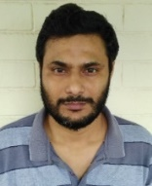
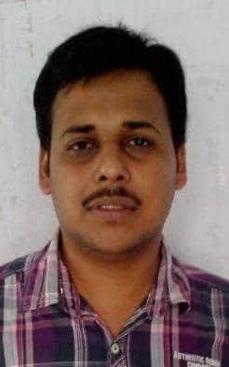
MATHEMATICS
Academic Departments
The Department of Mathematics being an integral part of a fledgling Institute in a rural part of Purba Bardhaman has started its journey since the inception of the College in 2015, offering three years B.Sc. (Hons.) and B.Sc.(Gen.) programme with a group of young dedicated, innovative and accomplished faculty members. In this department the relationship between faculty and student has primacy. The teachers are worked with our students and guiding them through our curriculum of study. The department is known for the quality of its teaching and mentoring. Students are always encouraged to take advantage of the many opportunities they have, to learn from the wisdom of our teachers, to work alongside them, to join them in interrogating ideas and to take intellectual risks. This department is a place where free and orderly thinking is cultivated, one where every idea is tested in a crucible of critical reflection. Thus we can boast off to promote this department as the best place to begin the thoughtful and arduous process of developing analytical habits of mind, a character of confidence and integrity and the discipline of respectful engagement with others. The salient features of grooming students in this department are that you must push yourself to always ask the next question, always take your thinking to another level, always view issues from an alternative perspective which a student ought to acquire while studying mathematics in his undergraduate programme. During this pandemic the department endeavours to facilitate all its students in the e-learning process through various virtual mods.
Faculty Members:
Prof. (Dr.) Krishnendu Dutta
Principal,
Specialization: Topology, Real-Analysis
M.Sc., PhD (CU).
Dr. Mani Shankar Mandal (HoD)
Assistant Professor
Specialization: MHD & Fluid Mechanics.
M.Sc., Ph.D. (BU)
Dr. Dibakar Mondal
Assistant Professor
Specialization: Fluid Mechanics.
M.Sc., Ph.D. (JU)
Shri Tanmoy Mitra
Assistant Professor
Specialization: Functional Analysis
M.Sc. (BU)

Slide 11
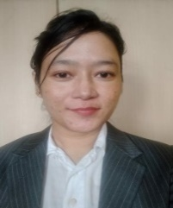
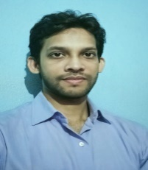
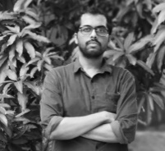
EDUCATION
Academic Departments
The Education Department of the College offers a six semester long B.A. (Honours and General) course since the inception of the College. The highly qualified and dedicated faculty members have made the Department an enviable centre of learning. It provides not only the desired academic support and guidance but also offers a spectrum of activities which is in consonance with the demands of society and global educational competitiveness.
The College library is well equipped with books and journals to allow the students to keep pace with the latest information and knowledge. The Department also emphasizes on continuous improvement in course curriculum, teaching and learning practices and evaluation methods to prepare the students with the current needs and high quality education. The Department has consistently yielded excellent results in both academic and co-curricular level.
Faculty Members
Dr. Rakhi Bhattacharya (HoD)
Assistant Professor
Specialization: Educational Technology & Educational measurement and evaluation (EME)
M.A., B.Ed., Ph.D. (KU)
Smt. Neetu Chettri
Assistant Professor
M.A. (C.U.)
Shri. Amir Hossain
Assistant Professor
M.A. (K.U.)
Shri. Sheikh Imran Pervez
Assistant Professor
M.A., B.Ed., M.Phil (JU)

Slide 12
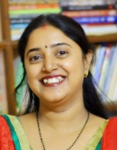
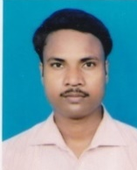
PHILOSOPHY
Academic Departments
Since the establishment of Govt. General Degree College at Kalna-1 in 2015, Department of Philosophy is engaged in spreading the knowledge amongst the society. Presently, the department offers UG with specialization (Honours) only, but UG with general course in philosophy is expected to commence from upcoming academic session.
Much of what is learned in philosophy can be applied in virtually any endeavor. This is both because philosophy touches so many subjects and, especially, because many of its methods can be used in various fields. Philosophy contributes uniquely to the development of expressive and communicative powers. It provides some of the basic tools of self-expression, here the faculty members train the students’ to develop skills in presenting ideas through well-constructed, systematic arguments.
The department houses a dynamic mix of personnel having experience and expertise in various avenues of Philosophy who extend a hand of support and provide access to various hands-on experiences and opportunities to enhance learning process.
The main motto of the Department has always been to help our students to learn to become ‘human’ first and to achieve this, we strongly believe, the knowledge in Philosophy would definitely be one of the best weapons. To enrich the learning experience the Department has upgraded its library with various text and reference books on Philosophy and related subjects from various authors.
Faculty Members
Smt. Priyanka Maity Das (HoD)
Assistant Professor
M.A. (JU)
Shri Sushabhan Deb Barman
Assistant Professor
M.A, M.Phil (NBU)
Shri Manik Kisku
Assistant Professor
M.A. (BU)

Slide 13
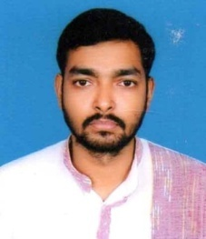
HISTORY
Academic Departments
The journey of the Department of History started in 2015 with the introduction of Pass Course and Honours Course under the University of Burdwan. The intake capacity for the undergraduate programme Honours is Thirty one seats. The faculty members make every possible effort to meet all the expectations and solve the queries of the students pertaining to the curriculum as well as their personality development. The department takes great pride in the excellent results of the students in every semester under the CBCS system. The all round development of our students’ is an important goal of our teaching learning endeavour and studying history will provide the young minds with a more rounded academic skillset and an improved ability to think critically – something they can take into the rest of their education.
The department continues to create an environment of igniting the minds of the learners through discourses on cutting-edge research in the discipline of history as well newly-emerging interdisciplinary fields. In a modern world where inclusivity is embraced no matter our background, an understanding of how past societies have integrated is key to humanity improving in the future are the valuable lessons taught by the team of skilled personnel.
The Department looks forward to a future of intellectual exchange at home and abroad, and to promote a better understanding of human experience through the lens of history.
Faculty Members
Shri Pranab Mistri (HoD)
Assistant Professor
M.A., B.Ed., M.Phil
Shri Koushik Chakraborty
Assistant Professor
M.A., M.Phil

Slide 14
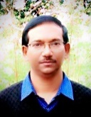
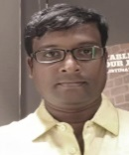
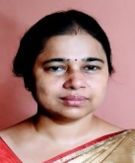
BENGALI
Academic Departments
Department of Bengali commenced its journey since the inception of the college. The department has continued to teach both Honours and General courses in the undergraduate level with success and satisfaction to all concerned. Currently, the department follows the CBCS system of education under the affiliation of The University of Burdwan.
Literature develops in students enduring values, such as integrity, compassion, loyalty and responsibility. The students of Bengali Language and Literature are offered the knowledge of Bengali grammar, history of Bengali literature. The texts students explore give them multiple opportunities to discuss and reassess their own values and beliefs. These act as a compass in life as students grow up. They develop a sense of individuality and creativity, as they develop their own opinions about issues in their texts, they learn to consider multiple perspectives and understand the complexity of human nature And therein lies the value of the subject – it prepares one for the ambiguities of life, to take uncertainties in one’s stride.
A strong group of faculty members work relentlessly not only in disseminating knowledge amongst the young learners but tirelessly work towards the growth and development of the young minds. Through classroom activities and activities outside the classroom opportunities are thrown open to them leading to polishing their talents, gathering experiences and building their personalities. A holistic approach to learning ensures to fully activate all aspects of a learner’s personality for more effective and comprehensive learning.
Faculty Members
Dr. Bidyut Kumar Das (HoD)
Assistant Professor
M.A.(C.U), Ph.D. (NBU)
Dr. Subrata Das
Assistant Professor
M.A., Ph.D. (KU)
Smt. Sila Rani Basak
Assistant Professor
M.A. (JU)

Slide 15
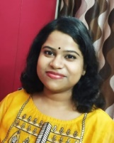
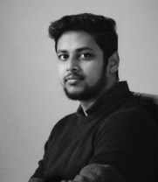
ENGLISH
Academic Departments
The Department of English of the Govt. General Degree College at Kalna-I, began its academic journey in the year 2015. The teaching faculty of the department currently consists of three Assistant Professors having expertise on various fields of Art, Literature and History. Besides taking utmost care to fulfill and nurture the intellectual inquisitiveness of the students – both within and beyond the boundary of prescribed syllabus, this dynamic department takes special care to facilitate the holistic growth of its students. The steadily growing library of the college that already has an impressive collection of English texts and reference books, captivating teaching-learning methods adopted by the teachers, enthusiastic participation of students and warm teacher-student relationship ensure a learning environment that not only prepares the students for examinations but also motivates them to develop creativity, self-confidence and communication skills. Within the short time since its inception, the students of this department have left marks of their brilliance in University Examinations, Inter-Collegiate Cultural Competition, Debate Competitions, Mock Youth Parliament and multiple other fields.
Faculty Members
Smt. Sudesna Som (HoD)
Assistant Professor
M.A. (BU)
Smt. Aditi Sarkar
Assistant Professor
M.A. (BU)
Shri Anirban Banerjee
Assistant Professor
M.A., M.Phil (BU)

Slide 16
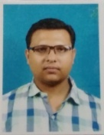
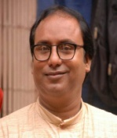
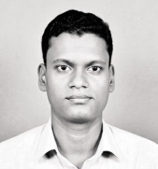
SANSKRIT
Academic Departments
Sanskrit has played a very essential role in the field of Indian society as well as Indian languages. Without proper knowledge of Sanskrit, comprehension of Ancient Indian wisdom may remain incomplete. Department of Sanskrit in our College started its journey on and from 13th July 2015 offering both B.A Honours and B.A General Courses.
The strength of the team which works together leads to the strong foundation of human bonds between teachers and students in an environment which caters to the needs and aspirations of the learners. Special monitoring of the students’ progress is achieved through periodical class tests as well as special doubt clearing classes which provides them with guidance in the pathway to success.
Along with academic aspect the team of teachers’ motivate the students and partake in enriching their knowledge and gather experiences through organizing seminars for students’ on a regular basis. The educators constantly strive to improve their teaching skills not only as a way of doing a better job producing well-educated members of society, but also to build their self-esteem through improved work quality.
The Department takes pride in the versatile talents showcased by the students through participation in various events organized by it like verse recitation competition and Wall magazine where the students contribute, interact and learn. To encourage and aid the students thirst for knowledge a wide range of rare and renowned Sanskrit books are accessible in the College Library.
Faculty members:
Dr. Chiranjib Bandyopadhyay (HoD)
Assistant Professor
M.A, B.Ed, Ph.D.
Dr. Sk. Asraf Ali
Assistant Professor
M.A, M.Phil, Ph.D.
Shri Kartik Mete
Assistant Professor
M.A, M.Phil

Slide 17
FACILITIES
Students' Corner
Availability of scheduled online classes through E- Learning mode via college domain and Google Workspace.
CBCS mode of academic interaction.
Well equipped college library with text and reference books recommended for new CBCS curriculum.
Well-equipped Smart Classroom.
Optimum access to Laboratory facilities for curriculum delivery of Science practical.
A newly formed “Computer Skill Enhancement Laboratory” for all students to ensure ICT awareness.
Minimum course fee in comparison to other colleges.
Availing of various Government Scholarship Schemes based on various eligibility criteria.
National Service Scheme (NSS Unit) grooms the learners to build social awareness and deliver community services.
College NSOU Centre plays a vital role in providing opportunity to enroll in various certificate and correspondence courses.
College Office provides the students with essential administrative support around the clock.
Faculties work as vocational guides and extend their support to ensure academic, professional and mental well-being of learners.
Students are encouraged to participate in sports. New college campus has a large play ground and necessary equipment to support Co-Curricular activities.

Slide 18
LIBRARY
Students' Corner
Library is not just another room in an academic institution. Especially in higher education, the use of library is directly related to what kind of scholastic minds the institute is going to produce. Many enlightened minds stated “I have never been to a classroom. That’s why I chose library.” Not that classroom teaching learning is secondary but in GGDC Kalna –I, we take particular interest in building a habit of using library among students. A vast majority of our students are first generation learners. Therefore using library -
Boosts their confidence in self study
Propagates true meaning of education
Brings out the future scholars among them
Helps them find the joy of learning
In addition to all these, library helps to bring knowledge without discrimination. Anyone seeking education can find anything they want from a library. Currently we have 7138 books. With ongoing CBCS structure, college library was renovated in this session and currently has thousands of books relevant to CBCS curriculum. Faculty members of each subject get involved directly with the help of library sub-committee to update the stock of books, add latest editions and include new arrivals from each subject of learning. Currently library is managed by experienced office staffs who make it their duty to serve learners as best according to the best of their ability. Library also has computer support and soon would run via relevant software to increase efficiency.
With current online classes and E- learning, we have already started using online repositories and resources by sharing links on lessons. In future, we would like to extend online access of books through our college website. Another important development is inclusion of spacious reading room in library. Regular library oriented self study classes with the guidance from faculty members have become very popular among students. Especially with latest inclusion of vast reference books and vocational guide books, we believe college library would become a joyous experience of learning for students.

Slide 19
ICT BASED LEARNING
Students' Corner
Smart Classroom
Our college has a smart class room comprising a wall mounting projection facility, smart board, audio aid to help students develop interest in respective fields of knowledge. This provides an excellent opportunity to promote ICT enabled teaching-learning methodologies along with the traditional chalk and talk methods. Innovative methods and ingenious technology, coupled with the academic progress of our esteemed faculty, provide the students with ample resources and attract them towards a better understanding of their curriculum. Moreover, it enhances their ability to delve deeper into themes and issues, develops new ideas and engages them to bring forth productive interactive sessions.
The college has an 120 seated fully air conditioned auditorium with modern audio-visual aid to conduct seminars and symposia and thereby help in improving students' academic attainment. Eminent personalities and organizations visit our college premises on different occasions and deliver lectures addressing students and encourage them to learn, grow and engage towards the greater common good.
Auditorium

Slide 20
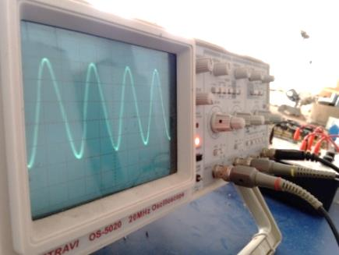
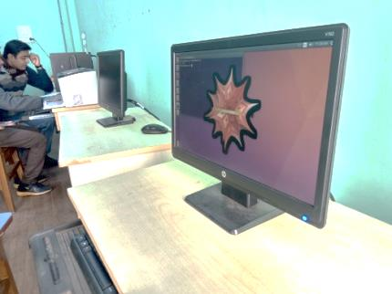
LABORATORIES
Students' Corner
Science & Computer Laboratories
Department of Physics has state-of-the-art laboratory and a dedicated computer laboratory compatible with CBCS syllabus.
Department of Chemistry has a laboratory with modern equipments following the needs of CBCS curriculum.
Department of Mathematics has a separate computer laboratory equipped with advanced generation of computers.
In addition to this, our college is in the process of opening up a new computing facility aimed to expose basic computer knowledge to our beloved students, from different backgrounds.

Slide 21
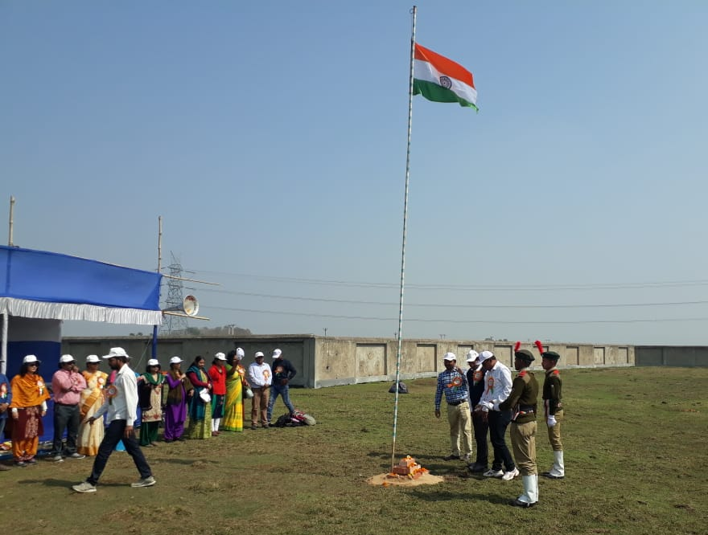
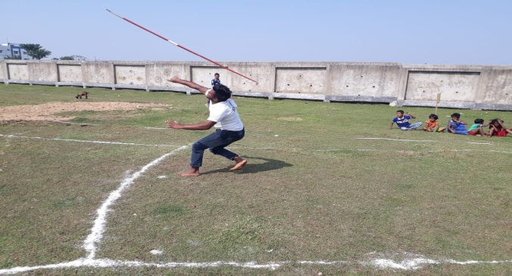
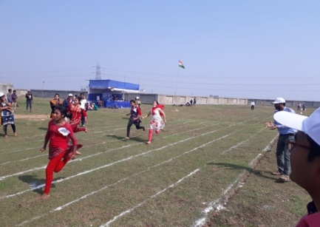
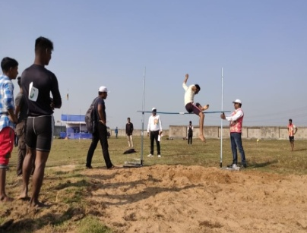
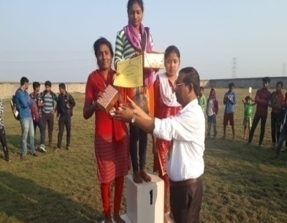
SPORTS & GAMES
Students' Corner
The college provides its students with games and sports facilities. The college sports room has arrangement for indoor games like carrom. There is also a badminton and volley ball court in the college campus. The college also provides opportunity for regular practicing of various throwing and jumping events. The college organizes annual sports in its own play ground each year (organizing events like various running, competitions, races, jumping and throwing). Besides this, the college also participates in various inter-college sports events. The college distributes prizes and certificates to its students during the annual sports.
This year, college organized first ever “Online Sports” on 23/07/2021 in following categories:
Sports Quiz
Story telling
Cross words
Yoga

Slide 22
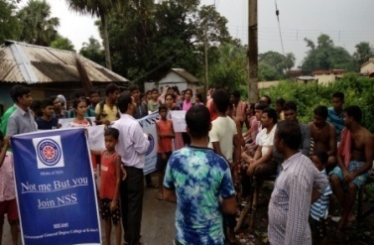
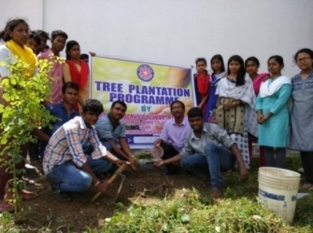
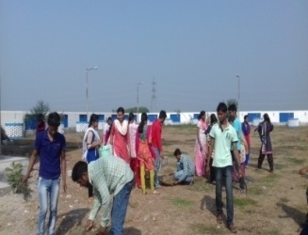
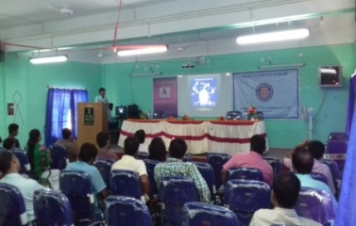
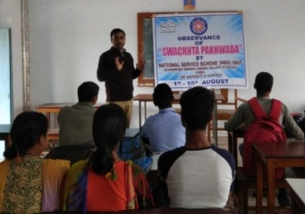
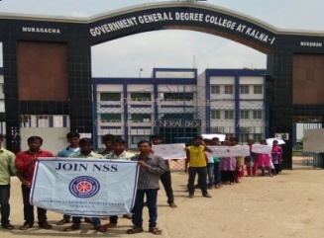
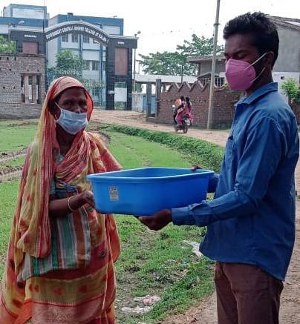
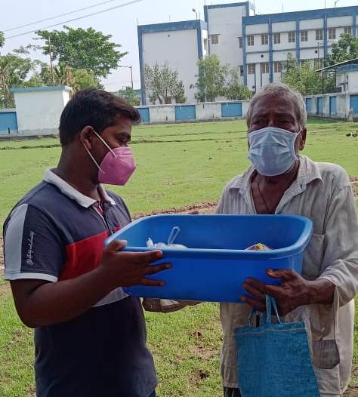
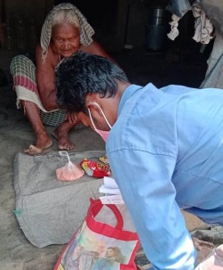
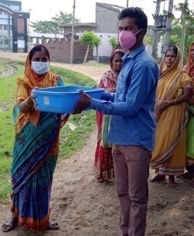
OUTREACH ACTIVITIES
Students' Corner
College NSS unit was opened in the year 2017.
Regular programs with direct participation of students took place.
e.g. HIV awareness programme, Observation of Constitution Day, Tree plantation programmes, Swachhta Pakhwara program, Awareness programs in neighbouring locality etc.
During the pandemic situation, college students continue to engage themselves in Social Outreach Programme by helping local needy villagers by supplying foods and sanitization materials.

Slide 23
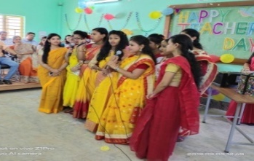
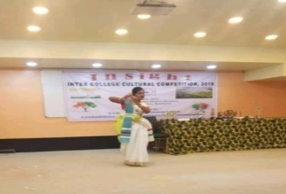
CULTURAL EVENTS
Students' Corner
Online celebrations during Pandemic
05/09/2020: Our students honoured us with love to commemorate Teachers‘ Day.
26/09/2020: 200th birth anniversary of Ishwar Chandra Vidyasagar was celebrated with grandeur and pomp.
14/04/2020: B.R. Ambedkar's birth anniversary was honoured by a “Corona Awareness” lecture with the help of NSS.
12/01/2021: Swami Vivekananda’s birthday was celebrated with extreme positivity and splendour.
23/01/2021: Netaji’s birthday was observed for his sacrifice towards our freedom fighting movement.
21/02/2021: Bhasha Divas was celebrated in collaboration with Bengali department.
09/05/2021: Government General Degree College celebrated Rabindra Jayanti.
16/06/2021: Department of Sanskrit organized a cultural program "Asharoshyo Prothom Dibose“.
Our students have participated in the 2019-20 Inter Collegiate Culture Competition and achieved the 1st , 2nd and 3rd positions in singing and dancing respectively.
Our students have participated in the Mock Youth Parliament Competition, 2019-20 and secured the 3rd position in individual merit.
Our students have also took part in the Debate Competition held in Hooghly Women's College 2019-20 and secured 2nd position.
Few Cultural Milestones

Slide 24
ONLINESTUDY
Teaching-learning methodology during pandemic
Following the Covid-19 Pandemic, various online teaching-learning methodologies were adopted by the College for the smooth conduction of academic activities:
Implementation of LMS (Learning Management System) via Google Work Space for Education.
Creation of dedicated Workspace IDs for all students through college domain.
Conduction of online classes in Google Classroom with access to the recording of lectures.
Use of Google Classrooms as repository of study materials and lecture notes.
College also has a dedicated E-Learning portal to share e-learning resources and arrange Online Examination.
Conduction of lab experiments using Virtual Lab and FOSSEE.
Communication with the students through dedicated SMS gateway.
Apart from teaching the entire syllabus, the faculties arrange extra tutorials, remedials and practicals as and when necessary.
In addition to the university prescribed mode of examination and evaluation, teachers take recourse to formative assessment to identify gaps in students’ knowledge.
Online Mock tests are conducted to prepare students for the semester end online examination.

Slide 25
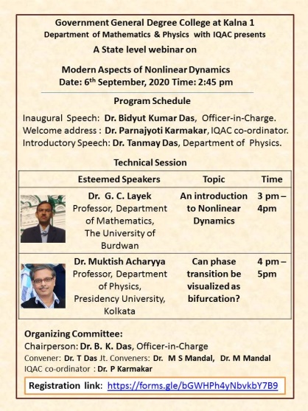
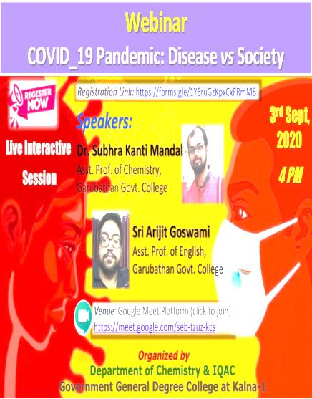
WEBINARS
Teaching-learning methodology during pandemic
To push the boundary of knowledge beyond regular classroom activities, the college organizes regular Seminars . Due to the outbreak of pandemic of COVID-19, last year seminars were conducted in online mode.

Slide 26
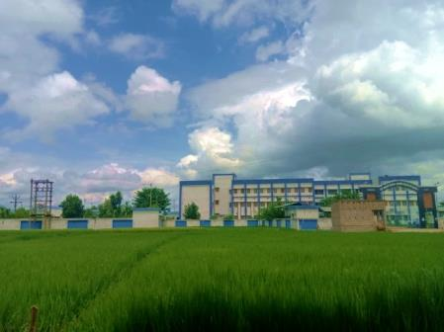
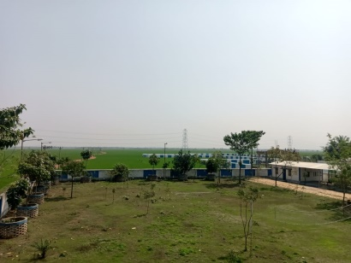
GREEN & CLEAN
Green Campus
Sustainable living has become an essential way of life for future generations. Therefore, education plays a vital role in inspiring young learners to maintain an ecological balance and become “Green Citizens”. Green campus is one such initiative towards that direction.
GGDC Kalna-I focuses on “Green Campus” by creating awareness, sharing knowledge and inculcating eco-friendly environment. The college administration plays an active role in implementing environmentalism into practices of daily life.
College authority also wishes to use alternative energy resources, rain water harvesting, reuse and waste management etc. Presently, we have a lush green college campus which is a “plastic free zone”.
Awareness programmes in collaboration with NSS, sensitization through expert–learner interaction are held on regular basis. Owing to its rural location, learners already have strong affinity towards nature and its beauty. The institute is looking forward to use all these human resources and natural resources to extend the idea of green campus into sustainable “Green Locality”.

Slide 27
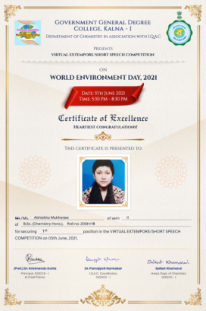
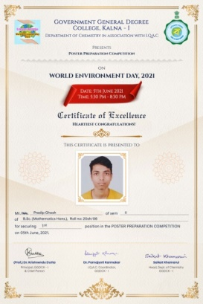
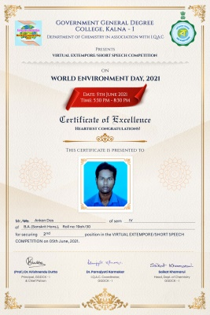
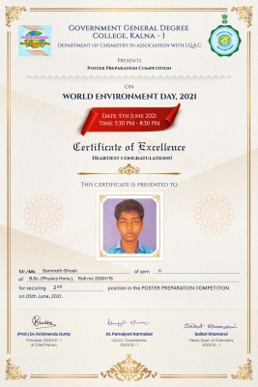
GREEN & CLEAN
World Environment Day Celebration
The college has organized Extempore & Poster competition among students on World Environment Day on 05.06.2021.
Among the participants, 1st , 2nd and 3rd prize in each division were awarded to encourage our students.

Slide 28
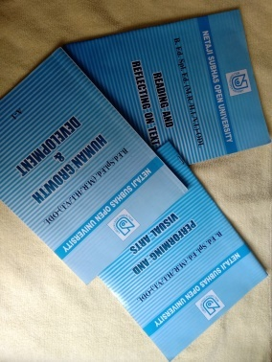
NSOU
Distance mode of Education
Netaji Subhas Open University is a premier State Open University in India. We have a Study Centre in our College since 2016. We offer Post Graduate Courses as follows:
1. Post Graduate Programme in Bengali (PGBG), English (PGEG), History (PGHI), Education (PGED), Mathematics (PGMT), Political Science (PGPS), Public Administration (PGPA), Public Relations & Advertising(PR&AD).
2. English Language Teaching (ELT),
3. Master of Social Work (MSW),
4. Master of Library and Information Science (MLIS),
5. Bachelors of Library and Information Science (BLIS),
6. Journalism and Mass Communication (JMC).
We also offer Vocational Courses like ‘Amra Pari’ (Women Education) and different Certificate Courses (Duration: six months). A student may seek admission in the ‘Amra Pari’ course while she continues her regular studies.

Slide 29
KEy NoTES
Institutional Governance
AQAR preparation
We have prepared AQAR for Academic Year 2019-20 which is an initiation for accreditation of this institute through NAAC in near future.
NPTEL local Chapter
We are proud to announce that the institute has been registered as a NPTEL local chapter through SWAYAM. portal.
Reduced Admission fees
Eyeing on the Challenged economic situation the college has decided to waive sessional fees for the current semester.
Hassle free form fill-up & Admission
Due to pandemic of COVID-19, college has launched a hassle-free online Admission & form-fill up portal along with fees payment with an option to check subject combinations and mobile number.
Student data management
Students are always the backbone of an educational institution. To preserve their data, the college is in a process of developing a student management software in web version.
Outcome based educational parameters
The college strictly adheres to the outcome based educational parameters with preparation of course outcome, lesson plan and graduate attributes.
Solar cell installation
Initiation for installation of Solar cell in Electrical grid of the college as a measure of renewable energy at its best use.

Slide 30
IQAC
Internal Quality Assurance Cell
The College has a very dynamic Internal Quality Assurance Cell (IQAC) composed with renowned figures ranging from Academicians to Physicians. Here is details of the same.
Sl no | IQAC chair(s) | Name of the Officer
1. | Ex Officio Chairperson | Dr. Krishnendu Dutta, Principal, Government General Degree College , Kalna-I
2. | Senior Administrative Officer | Dr. Santanu Chakrabarty , Principal, GGDC, Singur.
3. | External Expert | Dr. Sanjoy Kumar Roy , Associate Professor . Durgapur Govt. College
4. | Dignified Person of Society | Dr. Krishna Ch. Barai, Superintendent, Kalna Hospital
5. | Teacher Representatives | i) Dr. Mani Shankar Mandal Asst Prof. Dept of Mathematics Ii) Smt. Neetu Chettri Assistant Prof. Dept of Education Iii) Dr. Mahatsab Mandal Assistant Prof. Dept of Physics Iv) Dr. Subrata Das Assistant Prof. Dept of Bengali V) Dr. Bidyut Kumar Das Assistant Prof. Dept of Bengali Vi) Shri. Anirban Banerjee Assistant Prof. Dept of English
6. | Coordinator | Dr. Parnajyoti Karmakar Assistant Prof. Dept of Chemistry

Slide 31
RULES & REGULATIONS
Things to follow in our College
Students must be well informed about the notices displayed on the college notice boards/College Website.
Regular attendance as per University norms is obligatory for each student to appear in the University Examination.
Students are to submit application to the Principal for Character Certificate, Railway Concession, Identity Card, etc. at least 7 days in advance to the Principal’s Office.
Students admitted to this college are to abide by the Rules and Regulations of the College, University and orders of the Principal. No student can plead ignorance of such rules and orders.
Ragging in any form is strictly prohibited. Report on this matter, if found true, would lead to cancellation of admission or suspension for an academic year.
Students are advised to present themselves in dresses in tune with the environment of an educational institution.
The College Authority holds the right to issue transfer certificate or rusticate a student found guilty of an offense or undisciplined behavior, if it considered that such action is necessary in the interest of the college, without assigning any reason.
A student must carry with him/her updated Identity Card issued from the Student Section of the College.
Students must keep the college premises clean and maintain the sanctity of the college. Silence is to be observed. The corridors, staircases and the college premises are not meant for loitering and lounging.
If a student is absent from the classes without notice and without proper reason for more than 15 days, his/her name would be struck off from the college register.

Slide 32
MERIT INDEX
Eligibility Criteria
B.Sc. & B.A. Honours courses
Eligibility* : 45% both in aggregate and Honours Subject
Aggregate calculation :As per BU rules
Merit Index Calculation Total of best five subjects’( including at least one language ) in H.S. /equivalent exam marks (in percentage) = X₁ SECONDARY EXAMINATION MARKS IN PERCENTAGE = X₂ MARKS IN THE SUBJECT APPLIED = Y MERIT INDEX, M = 0.6 * X₁ + 0.4 * X₂ + Y
In absence of honours subject in Higher Secondary or equivalent, higher mark between Bengali and English will replace the honours subject’s mark.
B.Sc. & B.A. General courses
Eligibility* : Passing H.S. or equivalent examination within eligible year
Aggregate calculation : Best 5 subject marks
$$\text{Merit} \text{Index} \text{Calculation}$$ $$\text{Total} \text{of} \text{best} \text{five} \text{subjects}\text{’( }\text{including} \text{at} \text{least} \text{one} \text{language}\text{ ) }\text{in} \text{H}\text{.}\text{S}\text{. /}\text{equivalent} \text{exam} \text{marks}\text{ (}\text{in} \text{percentage}\text{) = }\text{X}\text{1}$$ $$\text{SECONDARY} \text{EXAMINATION} \text{MARKS} \text{IN} \text{PERCENTAGE}\text{ = }\text{X}\text{2}$$ MERIT INDEX, M = 0.6 * X₁ + 0.4 * X₂
# Detailed Tie-breaking policy can be found in College website.
* Eligibility criteria is subjected to B.U. admission guidelines for A.Y. 2021-22.

Slide 33
SEATS
Course wise detailed seat distribution*
Academic Session 2021-22
Subjects | Gen | SC (22%) | ST (6%) | OBC-A (10%) | OBC-B (7%) | Total
Physics (H) | 8 | 3 | 1 | 2 | 1 | 15
Chemistry (H) | 8 | 3 | 1 | 2 | 1 | 15
Mathematics (H) | 14 | 6 | 2 | 2 | 1 | 25
Bengali (H) | 17 | 7 | 2 | 3 | 2 | 31
English (H) | 17 | 7 | 2 | 3 | 2 | 31
Sanskrit (H) | 17 | 7 | 2 | 3 | 2 | 31
Education (H) | 17 | 7 | 2 | 3 | 2 | 31
History (H) | 17 | 7 | 2 | 3 | 2 | 31
Philosophy (H) | 17 | 7 | 2 | 3 | 2 | 31
B.A. (Gen) | 163 | 60 | 16 | 19 | 14 | 272
B.Sc. (Gen) | 11 | 6 | 2 | 3 | 2 | 25
# Reservation of Seats for the PWD Candidates is ≥ 5% of the intake (Category wise) as per The University of Burdwan notification dated 03/08/2020.
* Subject to changes according to B.U. Admission Notification 2021-22.

Slide 34
SUBJECT COMBINATIONS
Course wise available Subject combinations
Academic Session 2021-22
B.Sc. Honours
Sl No | Core Course (Honours Subject) | Available combination – General Elective
 |  | GROUP 1 | GROUP 2
1 | PHYSICS | CHEMISTRY | MATHEMATICS
2 | CHEMISTRY | PHYSICS | MATHEMATICS
3 | MATHEMATICS | PHYSICS | CHEMISTRY
B.A. Honours
Sl No | Core Course (Honours Subject) | Available combination – General Elective ( ONE EACH FROM GROUP 1 AND GROUP 2)
 |  | GROUP 1 | GROUP 2
1 | BENGALI | ENGLISH/SANSKRIT | EDUCATION/HISTORY
2 | ENGLISH | BENGALI /SANSKRIT | EDUCATION/HISTORY
3 | SANSKRIT | BENGALI / ENGLISH | EDUCATION/HISTORY
4 | EDUCATION | BENGALI / ENGLISH | SANSKRIT /HISTORY
5 | HISTORY | BENGALI / ENGLISH | SANSKRIT /EDUCATION
6 | PHILOSOPHY | BENGALI / ENGLISH | SANSKRIT /HISTORY
B.Sc. & B.A. General
SL NO | GENERAL COURSES | ANY THREE FROM THE FOLLOWING
1 | B.A. | SANSKRIT | HISTORY | ENGLISH/ BENGALI | EDUCATION
2 | B.Sc. | PHYSICS | CHEMISTRY | MATHEMATICS | X

Slide 35
ADMISSION FEES
Course wise Admission fees
Indicative Fee* to be paid at the time of admission in Semester I under UG Courses for the session 2021-2022
Sl. No | Courses | Admission fees (in Rupees)
1. | B.A. Honours | 1022/-
2. | B.Sc. Honours | 1307/-
3. | B.A. General | 847/-
4. | B.Sc. General | 1122/-
*The fees shown (subject to minor changes based on University Notifications) include admission fee, examination fee, laboratory fee, library fee, tuition fee (six months) etc.
* Session Fee has been waived for this academic session.

Slide 36
PROJECTED REACH
Miles to go
Infrastructural developments
Addition of class-rooms
Round the hour power back-up facility
Separate Science building
Add on course on value education.
Vertical and horizontal expansion of academics.
Organizing more student seminars, science fairs to expose students with cutting edge technology and augmented perception.
Introduction of Skill Development Programs for enhancement of students’ employability.
Village adoption through NSS unit of the college.
Science awareness program for local villagers.
Visiting nearby feeder agencies to promote educational atmosphere.
Academic developments
Commitment towards society

Slide 37
CONCLUDING REMARKS
Few final words
Government General Degree College at Kalna-I as a team is thrilled to look forward to the new academic session of 2021-22 with you on board. The platform of interaction might be virtual or face-to-face but be sure, we will be there for you all. With pandemic related challenges, the college administration has already arranged for the lowest fees possible for admission. You will continue to be our priority. Let’s make this journey, make good use of excellent opportunities provided by the esteemed faculties and infrastructures to explore your potential. Let us follow the essence of what our beloved poet once remarked, so that we can learn and grow together, “…the power of education which is one with life and only which can give us real freedom , the highest that is claimed for man, his freedom of moral communion in human world.”
For further admission related queries, kindly drop a mail to the following email id / Dial the following number:
admission@ggdck.ac.in
9883277057
You may also visit our Website :
https://www.ggdck.ac.in

